Slide 1


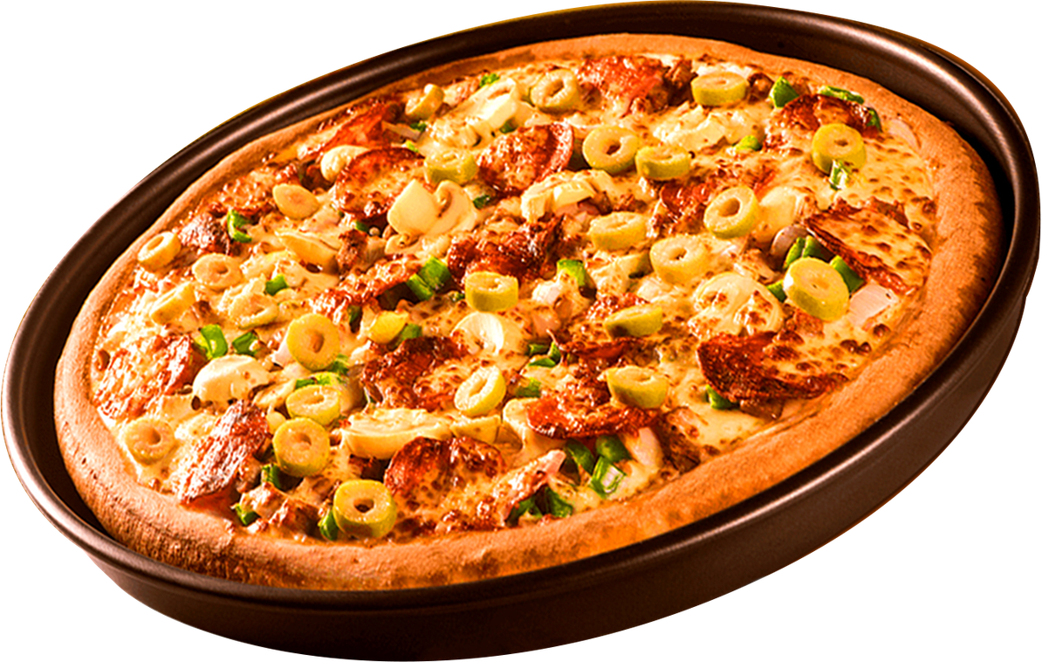


MANISH KASHYAP
Documentation>
Github>
Dashboard>
Aspiring Data Analyst
PIZZA SALES ANALYSIS
END-TO-END ANALYSIS
SQL PROJECT

Slide 2

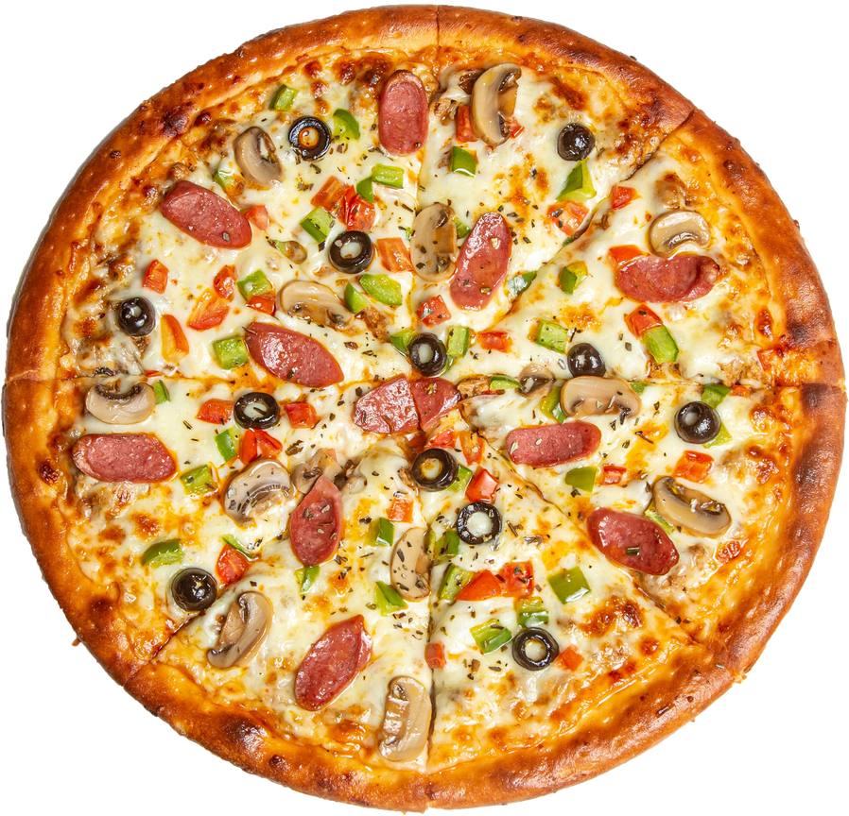
MANISH KASHYAP
Home
About
Contact
Aspiring data Analyst
HELLO !
I’M MANISH KASHYAP ASPRING DATA ANALYST
An end-to-end data analytics project focused on querying, cleaning, and extracting actionable business insights from a retail pizza sales dataset using Data Query Language (DQL).

Slide 3
Home
Contact
QUESTION I ANSWER
01
BASIC :
1. Retrieve the total number of orders placed.
2.Calculate the total revenue generated from pizza sales.
3.Identify the highest-priced pizza.
4.Identify the most common pizza size ordered.
5.List the top 5 most ordered pizza types along with their quantities.
02
04

Slide 4
01
About
Contact
ADVANCE :
1.Join the necessary tables to find the total quantity of each pizza category ordered.
2.Determine the distribution of orders by hour of the day.
3.Join relevant tables to find the category-wise distribution of pizzas.
4.Group the orders by date and calculate the average number of pizzas ordered per day.
5.Determine the top 3 most ordered pizza types based on revenue.
6.Calculate the percentage contribution of each pizza type to total revenue.
7.Analyze the cumulative revenue generated over time.
8.Determine the top 3 most ordered pizza types based on revenue for each pizza category.
$30

Slide 5
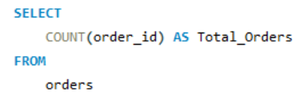
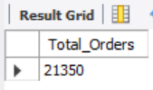

Home
About
Contact
RETRIEVE THE TOTAL NUMBER OF ORDERS PLACED

Slide 6
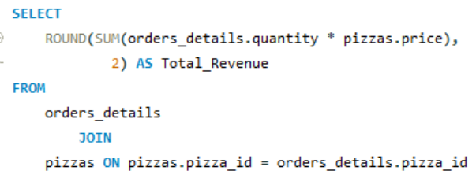

Home
About
Contact
CALCULATE THE TOTAL REVENUE GENERATED FROM PIZZA SALES

Slide 7
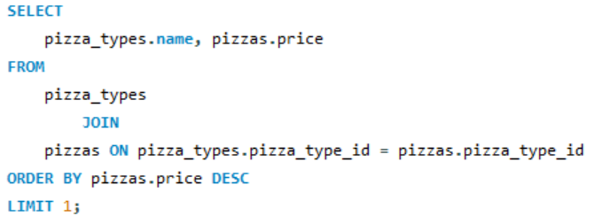
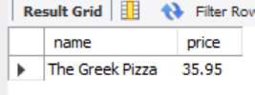
About
Contact
IDENTIFY THE HIGHEST-PRICED PIZZA
$30
$30

Slide 8
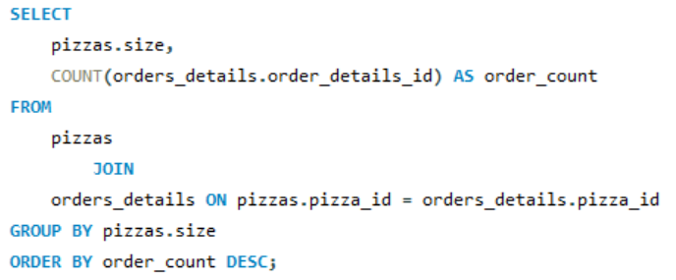
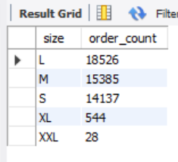
About
Contact
IDENTIFY THE MOST COMMON PIZZA SIZE ORDERED

Slide 9
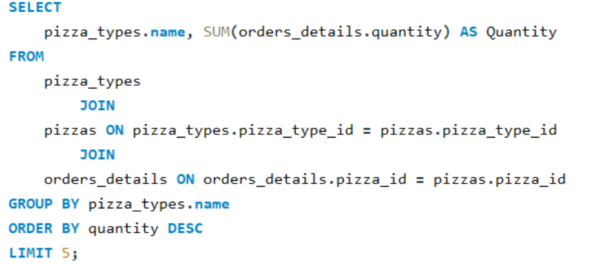
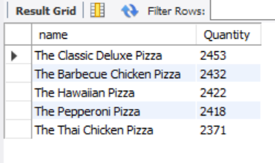
Home
About
Contact
LIST THE TOP 5 MOST ORDERED PIZZA TYPES ALONG WITH THEIR QUANTITIES

Slide 10
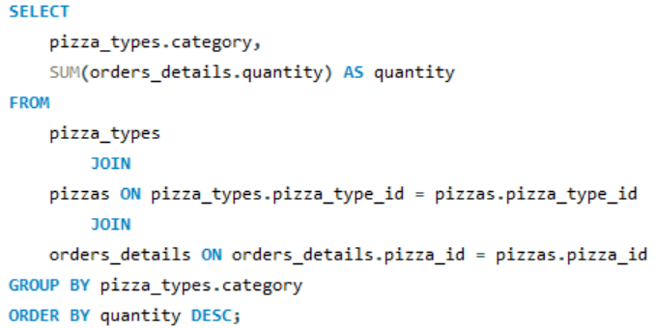
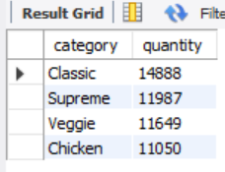
About
Contact
JOIN THE NECESSARY TABLES TO FIND THE TOTAL QUANTITY OF EACH PIZZA CATEGORY ORDERED.

Slide 11
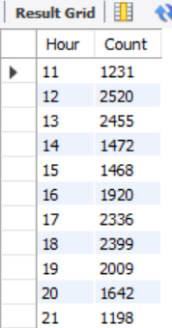
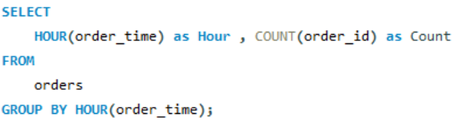
About
Contact
DETERMINE THE DISTRIBUTION OF ORDERS BY HOUR OF THE DAY

Slide 12
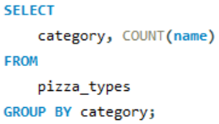
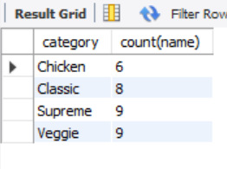
About
Contact
JOIN RELEVANT TABLES TO FIND THECATEGORY-WISE DISTRIBUTION OF PIZZAS.

Slide 13
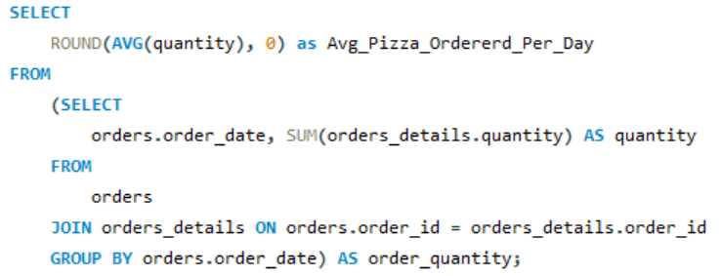
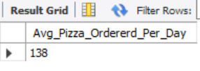
About
Contact
GROUP THE ORDERS BY DATE AND CALCULATE THE AVERAGE NUMBER OF PIZZAS ORDERED PER DAY.

Slide 14
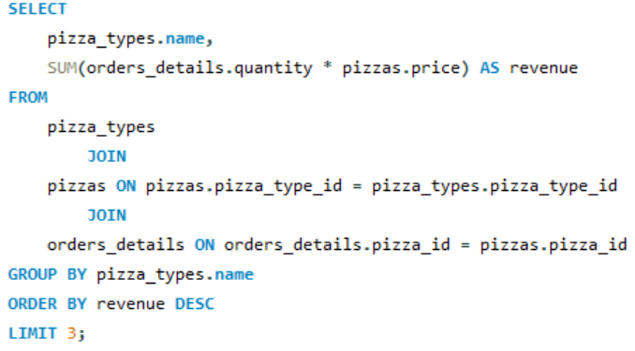
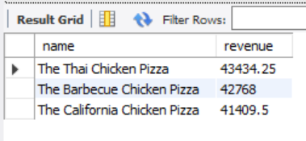
About
Contact
DETERMINE THE TOP 3 MOST ORDERED PIZZA TYPES BASED ON REVENUE.

Slide 15
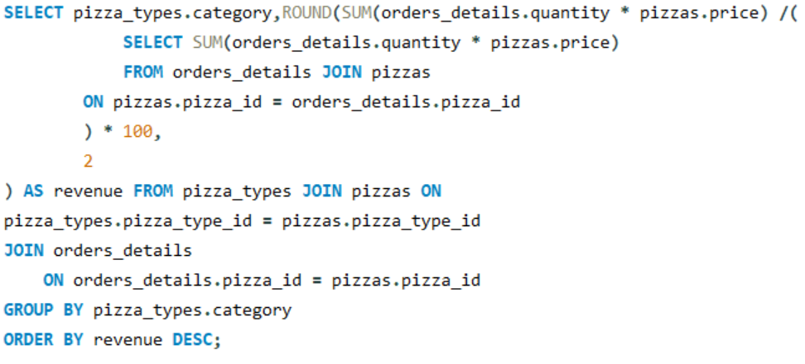
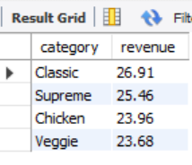
About
Contact
CALCULATE THE PERCENTAGE CONTRIBUTION OF EACHPIZZA TYPE TO TOTAL REVENUE.

Slide 16
About
Contact
JOIN RELEVANT TABLES TO FIND THECATEGORY-WISE DISTRIBUTION OF PIZZAS.

Slide 17
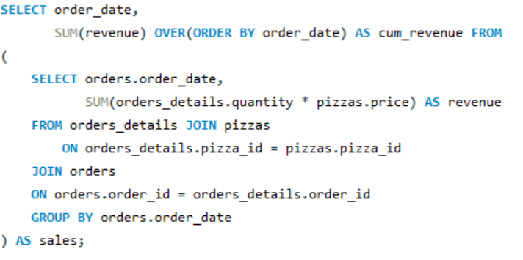
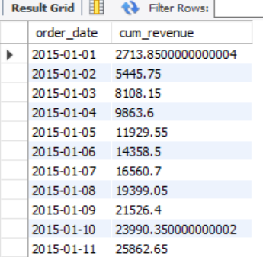
About
Contact
ANALYZE THE CUMULATIVE REVENUE GENERATED OVER TIME

Slide 18
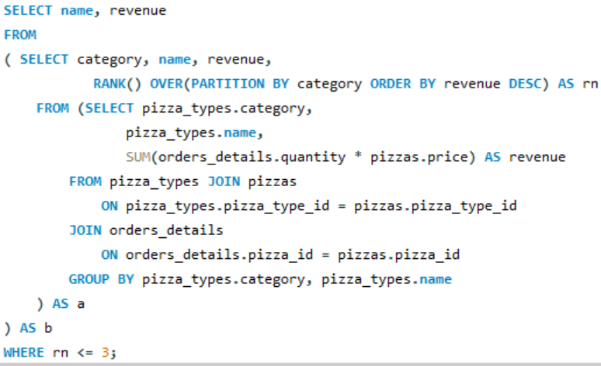
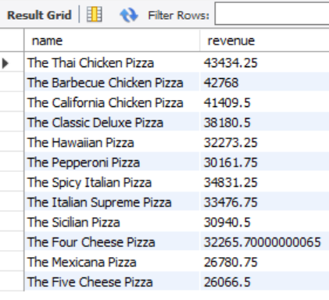
About
Contact
DETERMINE THE TOP 3 MOST ORDERED PIZZA TYPES BASED ON REVENUE FOR EACH PIZZA CATEGORY.

Slide 19
About
Contact
THANK YOU
FOR ATTENTION
GITHUB.COM\ILIKEMANISH

